Slide 1
Speedup the Debug Turnaround Time and Regression Run Time with SystemVerilog/UVM Test Dynamic Load
Horace Chan

Slide 2
Agenda
Overview
What’s New in Xcelium
Syntax and Tips
Use Model
Benefits and Results
Roadmap

Slide 3

Company Overview

Slide 4
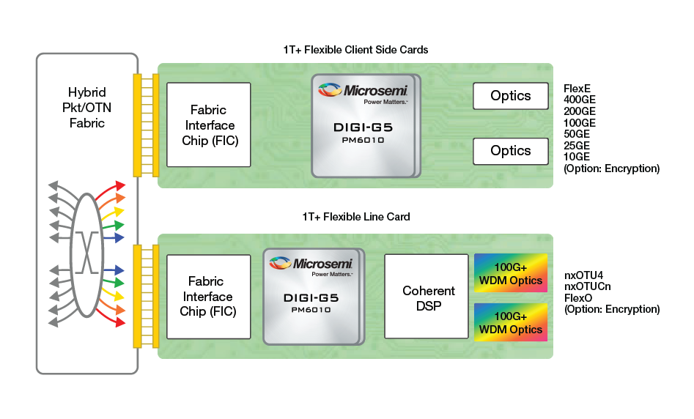
Optical Networking

Slide 5
Specman vs System Verilog
SystemVerilog is SLOW to debug
Primitive peek/poke/force only
No user inputs
Can’t change TB behavior once the simulation is running
Recompile, recompile, recompile
Specman is FAST to debug
Call any testbench function in run time
No recompile is needed
Support dynamic load of additional code at saved checkpoints
Rewrite existing sequence
Modify the behavior of existing methods
Add and launch new sequence

Slide 6
What’s in Xcelium
SystemVerilog/UVM Dynamic Test Load
Load new SV package into saved snapshot
Call testbench functions when the snapshot is reloaded
Dynamic Base Snapshot (DBS)
Time zero snapshot or saved snapshot
Dynamic Test Snapshot (DTS)
Contains the incremental new SV package

Slide 7
Syntax
Elaborate the Dynamic Base Snapshot
xrun –f base_ve_stuff.f \
-f dut_stuff.f \
-uvm \
-mkdbssnap –checkpoint_enable –plusarg_save\
-name dbsnap
Elaborate the Dynamic Base Snapshot
xrun new_test_pkg.sv \
-uvm –uvmnoautocompile \
-dbssnap after_initialization \
-dbsname dbsnap \
-name dbsnap
-input new_test.tcl

Slide 8
Save a snapshot
Use $save() SV system task in the TB
$save(“after_initialization”)
Use ncsim tcl save command in run time
xrun> save after_initialization
Does not support save into a different path in run time
Use –cds_implicit_tmpdir as a workaround at start time
Supports save into a different library
Watch out for cds library size explosion
Watch out for cds library lock

Slide 9
Override existing sequence after reload
Use tcl UVM command
uvm_factory –override –by_type \
old_test_seq new_test_seq
run
Use SV plus options in TB
uvm_cmdline_processor clp = new;
clp.get_arg_value(“+TEST_SEQ=“, test_seq);
w = factory.find_by_name(test_seq);
$cast(seq, factor.create_object_by_type(w,…);
Watch out: don’t use default UVM cmdline processor
Its SV plus options is not updated after reload
Always create your own new instance after reload

Slide 10
Call testbench function/task after reload
package new_pkg;
class new_code:
function new():
fork
uvm_root uvm_top = uvm_root::get();
tb_ve ve = uvm_top.find(“uvm_top.ve”);
// call testbench functions or tasks
ve.foo();
ve.bar();
join_none;
endfunction
endclass
new_code mycode = new;
endpackage

Slide 11
Exit after saving a snapshot
Use tcl variable to store exit state
Clear the tcl variable after reload
Use SV-DPI to call tcl prompt from SV (see cdnshelp)
task save_cp(string cp_name, bit exit);
if (exit == 1) begin
dpi_tcl_exec_cmd(“set exit_after_cp 1”);
end
$save(string_t’(cp_name));
#0;
tcl_rv = 0;
dpi_tcl_exec_cmd(“deposit tcl_rv [info exists exit_after_cp]”);
if (tcl_rv == 1) begin
$finish;
end
endtask

Slide 12
Use Model
Compile DUT and stable part of the TB with MSIE
Save a Dynamic Base Snapshot at time zero
Put each testcase and sequences in flux into its own package
MSIE elab time 5 mins vs DTS elab time 30 seconds
Probe minimum waveform to speed up simulation
Save a checkpoint periodically
Save a checkpoint after each key test phase
Rerun from the saved checkpoint to dump waveform for debug
Rerun from the saved checkpoint to try different scenarios

Slide 13
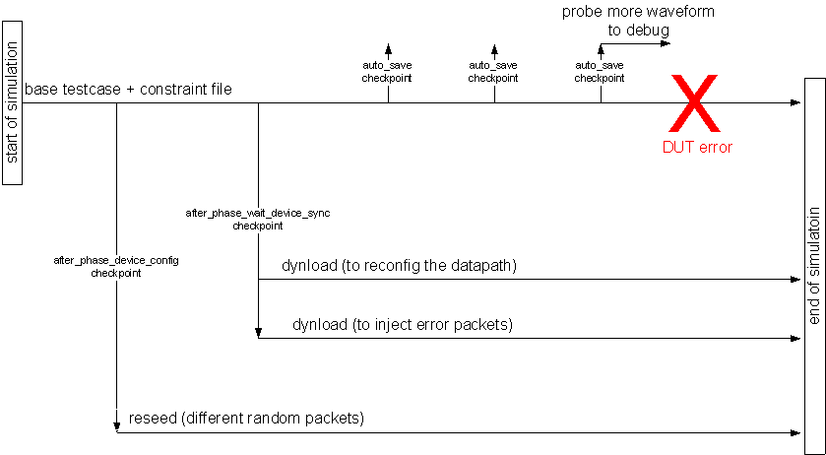
Checkpoint Usage Example

Slide 14
Benefits and Results*
Speed up the RTL debug turnaround time by 90%
Average time to failure in simulation is 6 hours
Reduce overall development time by 50%
Reduce the regression time by 25%
DUT initialization takes roughly 25%
* Based on data from previous project using Specman SAO dynamic load
SV dynamic load is still in alpha, not ready for deployment

Slide 15
Roadmap
SV dynamic load still does not support:
Simvision reinovke
Use ncsim tcl restart command to load new SV code
Save the checkpoint to a different path at run time
UVM default command line processor after reload
Xcelium mulit-core simulation
Issues with cds library corruption and lock up occasionally
Need a tool to copy the cds library to avoid dependency between runs
Build your next testbench with SV dynamic load in mind, use it when it is ready

Slide 16
Questions and Answers
Special thanks to
John Rose, Adam Sherer

